Slide 1
Statistics on Estonian forests and industry 2022

Slide 2
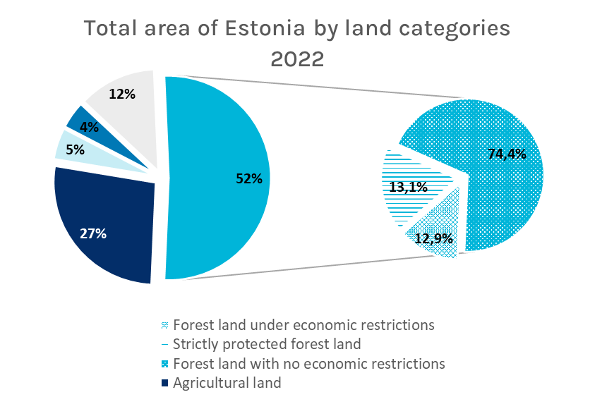
Source: Statistical forest inventory SMI, 2022

Slide 3
Source: Statistical forest inventory SMI, 2022

Slide 4
Source: Statistics Estonia, 2022

Slide 5
Source: Statistics Estonia, 2021

Slide 6
Source: Statistics Estonia, 2022

Slide 7
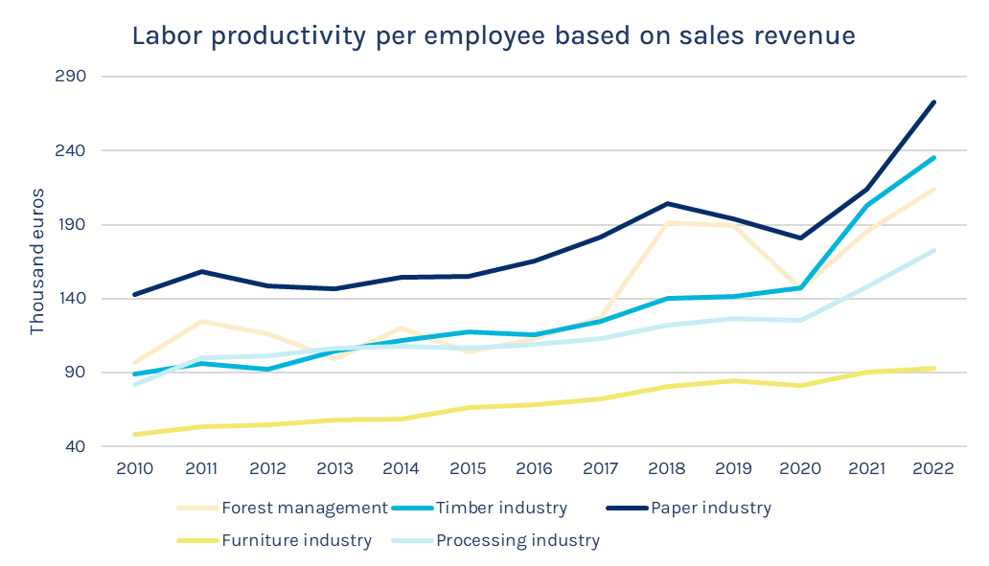
Source: Statistics Estonia, 2022

Slide 8
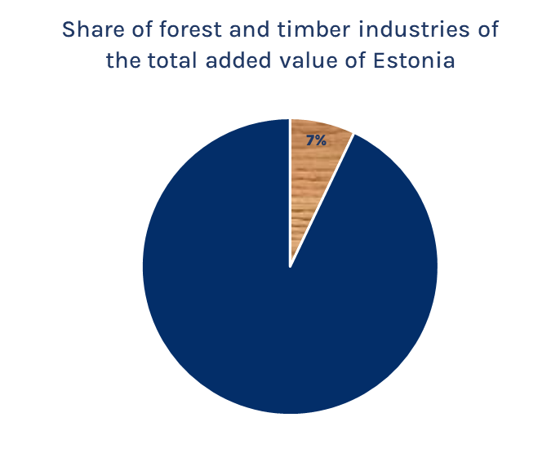
Source: Statistics Estonia, 2021

Slide 9
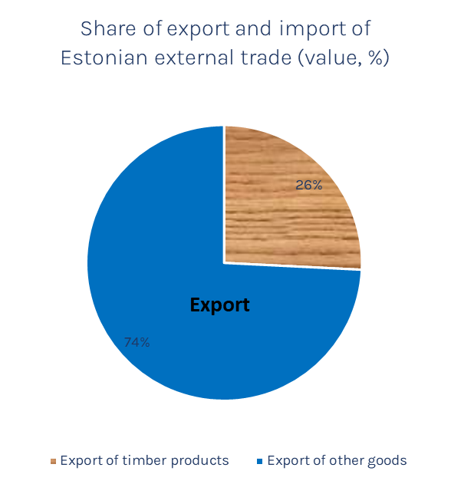
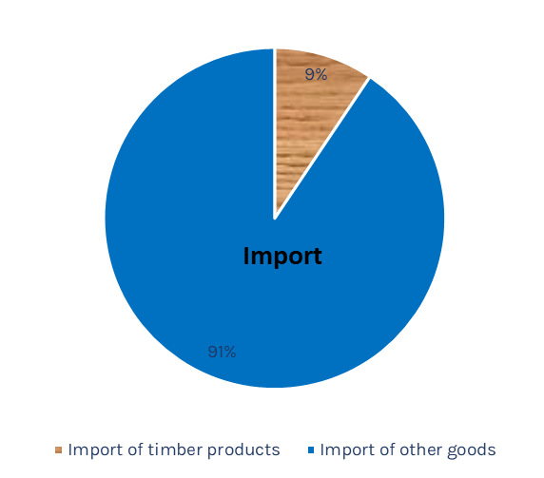
Source: Statistics Estonia, 2022
Source: Statistics Estonia, 2021

Slide 10
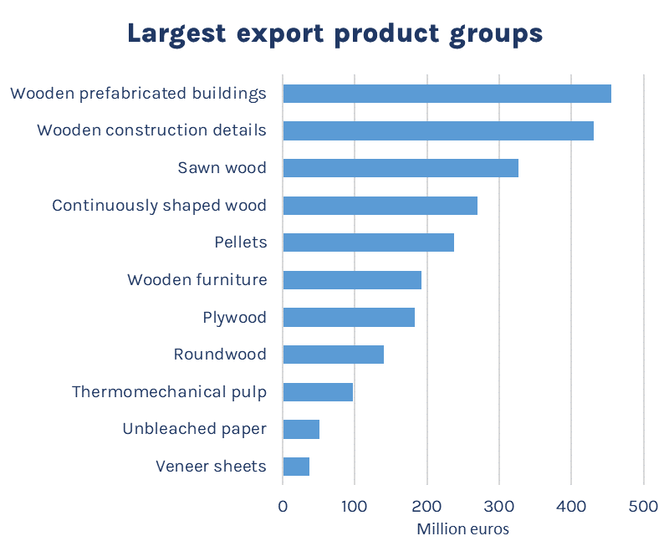
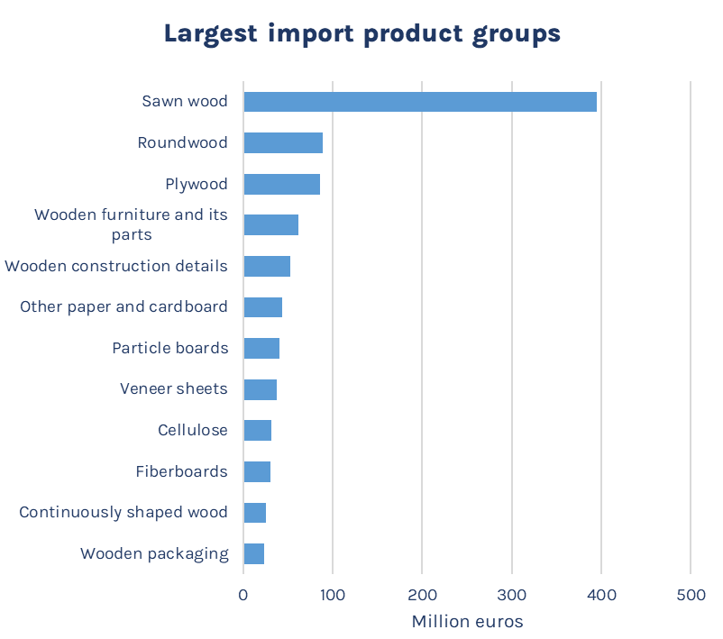
Source: Statistics Estonia, 2022

Slide 11
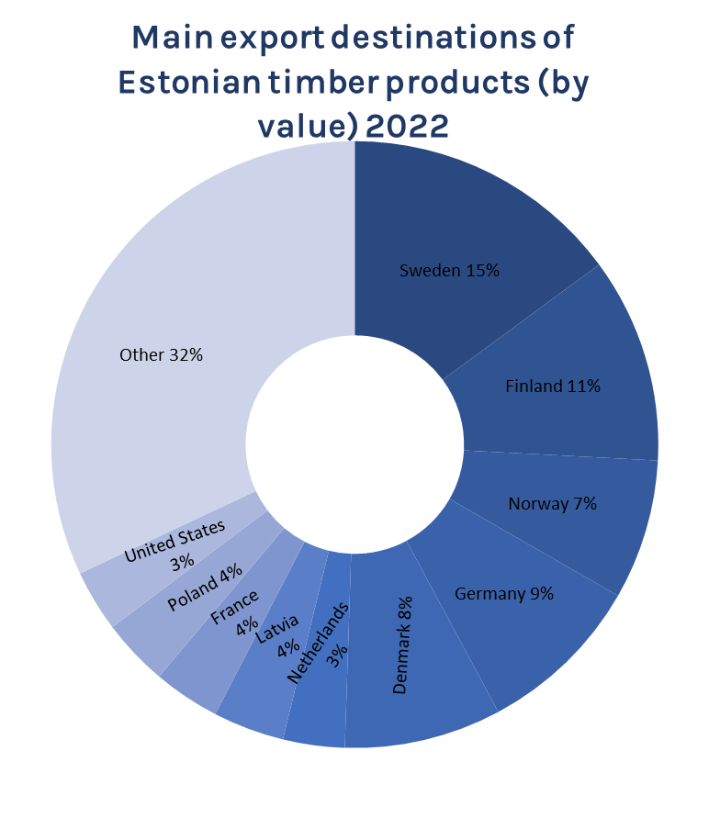
Source: Statistics Estonia, 2022

Slide 12
Source: Statistics Estonia, 2022

Slide 13
Source: Statistics Estonia, 2021

Slide 14
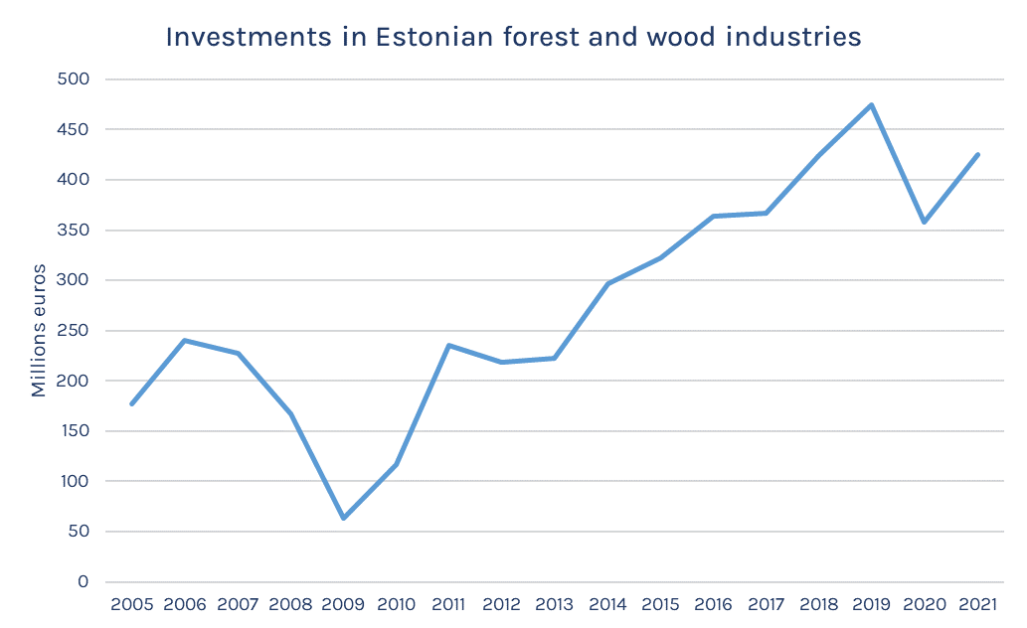
Source: Statistics Estonia, 2021

