Slide 1
Statistics on Estonian forests and industry 2024

Slide 2
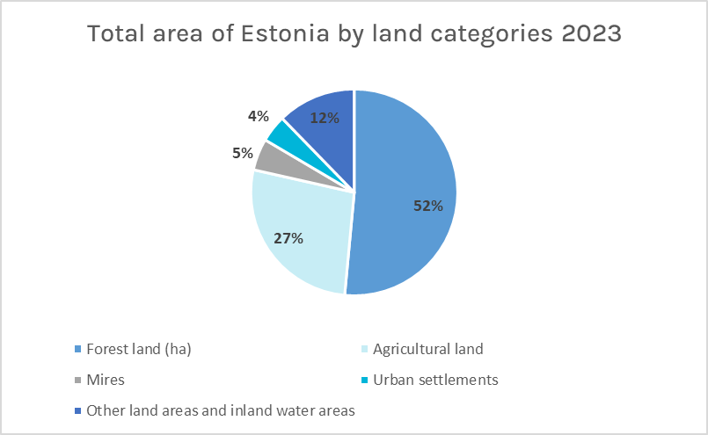
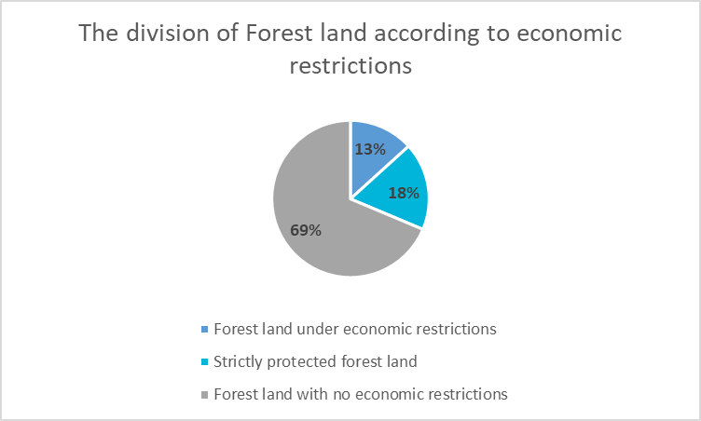
Source: Statistical forest inventory SMI, 2023

Slide 3
Source: Statistical forest inventory SMI, 2023

Slide 4
Source: Statistics Estonia, 2024

Slide 5
Source: Statistics Estonia, 2024

Slide 6
Source: Statistics Estonia, 2024

Slide 7
Source: Statistics Estonia, 2024

Slide 8
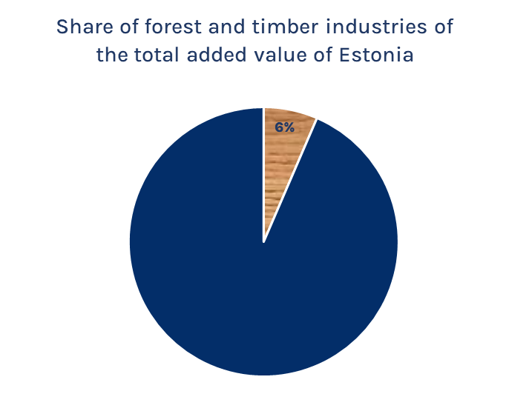
Source: Statistics Estonia, 2023

Slide 9
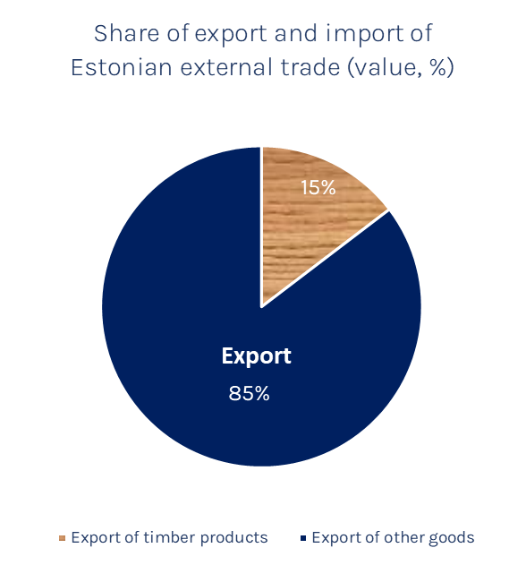
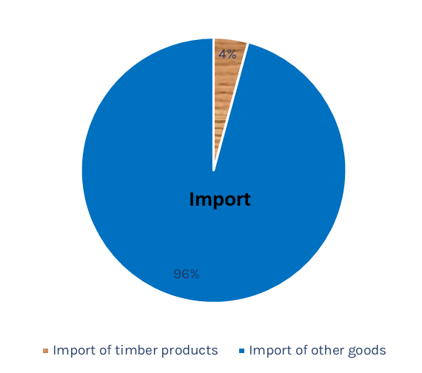
Source: Statistics Estonia, 2024
Source: Statistics Estonia, 2024

Slide 10
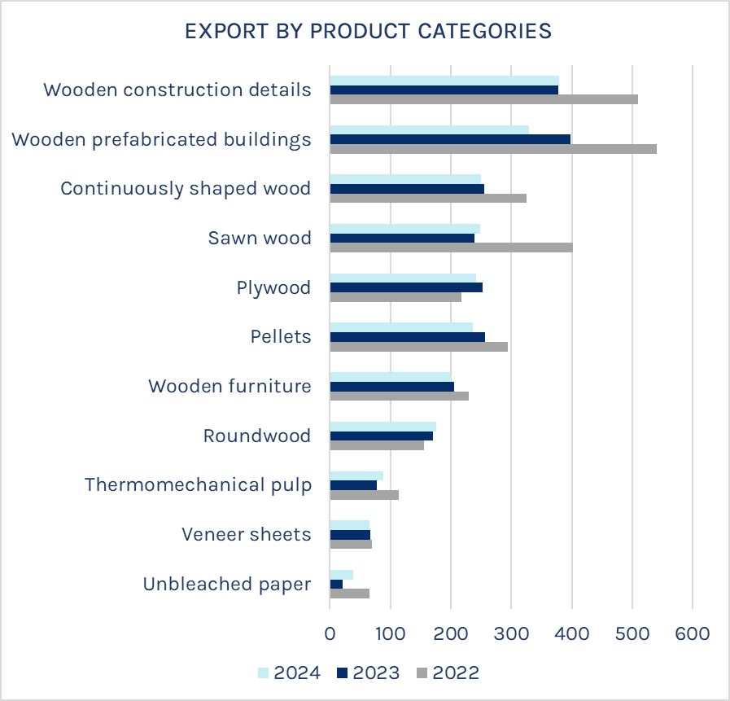
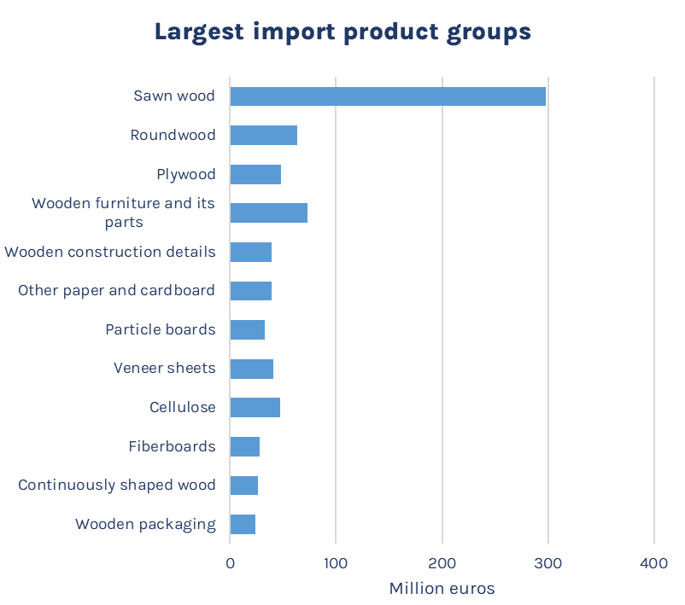
Source: Statistics Estonia, 2024

Slide 11
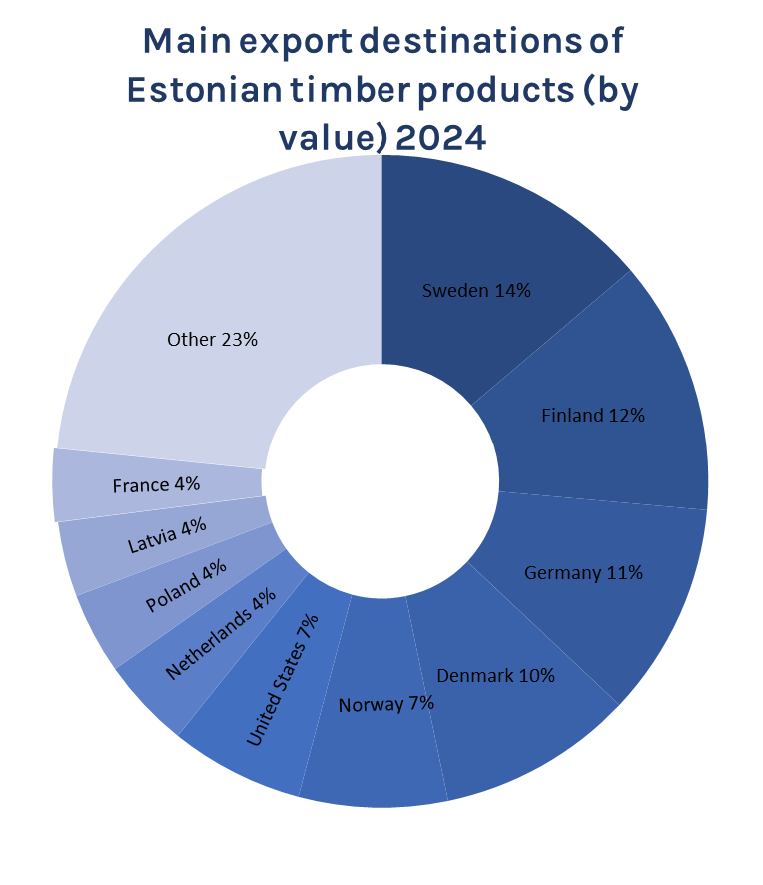
Source: Statistics Estonia, 2024

Slide 12
Source: Statistics Estonia, 2024

Slide 13
Source: Statistics Estonia, 2023

Slide 14
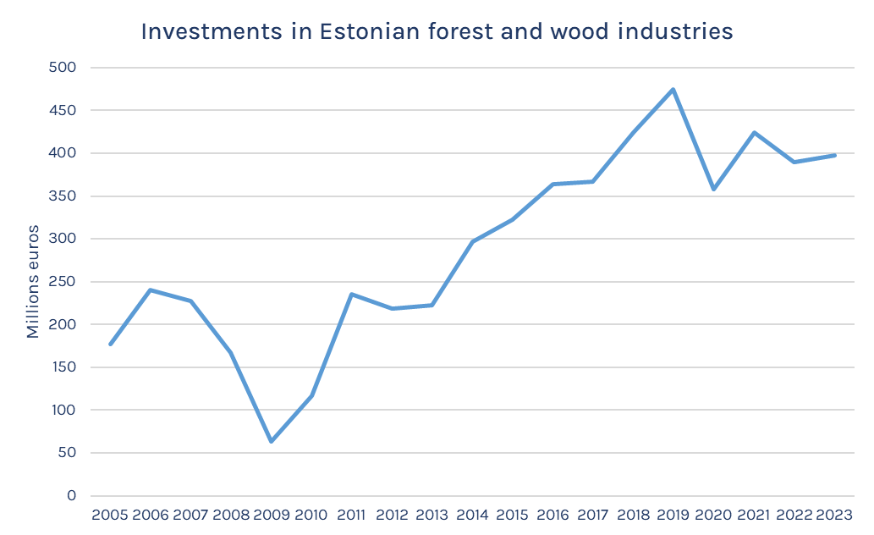
Source: Statistics Estonia, 2023

