Slide 1
Statistics on Estonian forests and industry 2025

Slide 2
Source: Statistical forest inventory SMI, 2025

Slide 3
Source: Statistical forest inventory SMI, 2025

Slide 4
Source: Statistics Estonia, 2025

Slide 5
Source: Statistics Estonia, 2025
*Data for the latest year are unadjusted preliminary statistics

Slide 6
Source: Statistics Estonia, 2025
*Data for the latest year are unadjusted preliminary statistics

Slide 7
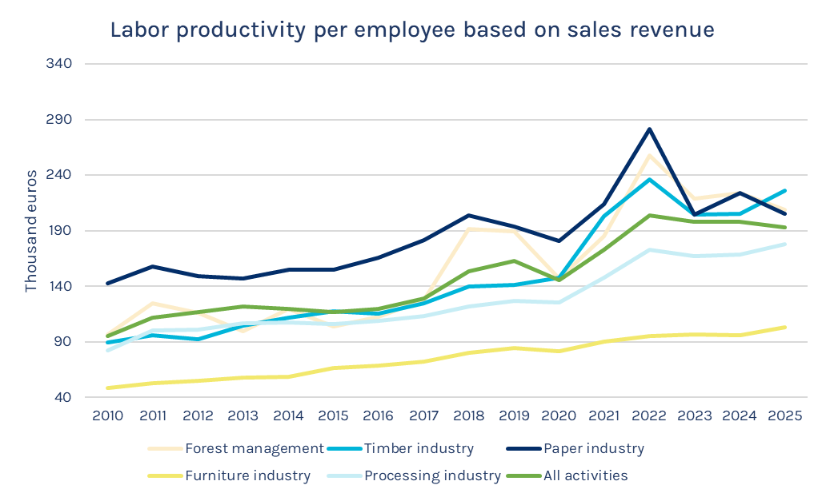
Source: Statistics Estonia, 2025

Slide 8
Source: Statistics Estonia, 2024

Slide 9
Source: Statistics Estonia, 2025
Source: Statistics Estonia, 2025

Slide 10
Source: Statistics Estonia, 2025

Slide 11
Source: Statistics Estonia, 2025

Slide 12
Source: Statistics Estonia, 2025

Slide 13
Source: Statistics Estonia, 2024

Slide 14
Source: Statistics Estonia, 2024

